Slide 1

Acropolis Institute of Technology & Research Department of Computer Science and Information Technology
Submitted to :- Prof. Vandana Kate
Associate Professor
Submitted by :- Navya Saxena
0827CO191037

Slide 2
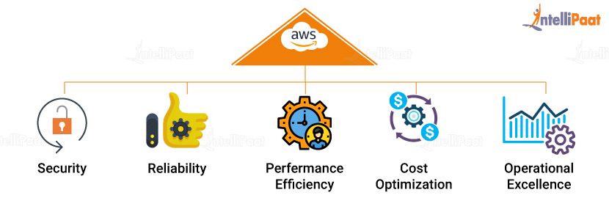
Introduction

Slide 3






Famous services using AWS

Slide 4

Table of contents

Slide 5

Traffic is a interruption
The main reason, websites and apps continue to slow down and ultimately crash under load is the disparity between traffic levels and the capacity of your website’s infrastructure.

Slide 6
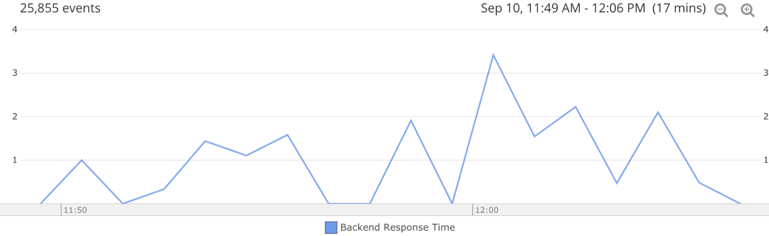
When does high traffic crash a website?
First: High traffic can crash a website if the website's server or infrastructure is unable to handle the increased volume of requests.
Fig 1.1

Slide 7
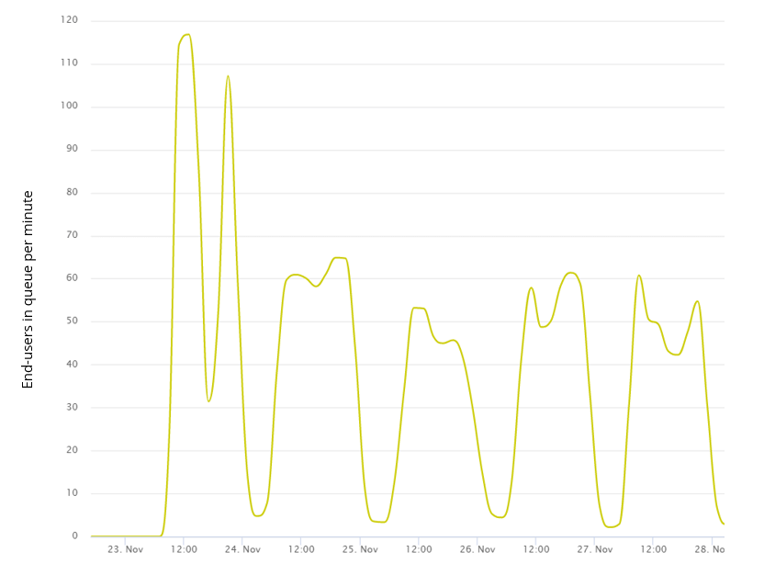
Second: Big name sales like Black Friday and Big Billion Day. They can drive traffic levels 30 times higher than a normal day.
Fig 1.2

Slide 8

What can I do to prevent website crashes?
1. Have you optimized your website’s performance?
2. Have you done load testing?
3. Where do your website’s excess users go?

Slide 9

What if, you don’t even require to monitor the traffic on your website ?
It is made possible by AWS services named as AUTO SCALLING AND LOAD BALANCING.

Slide 10
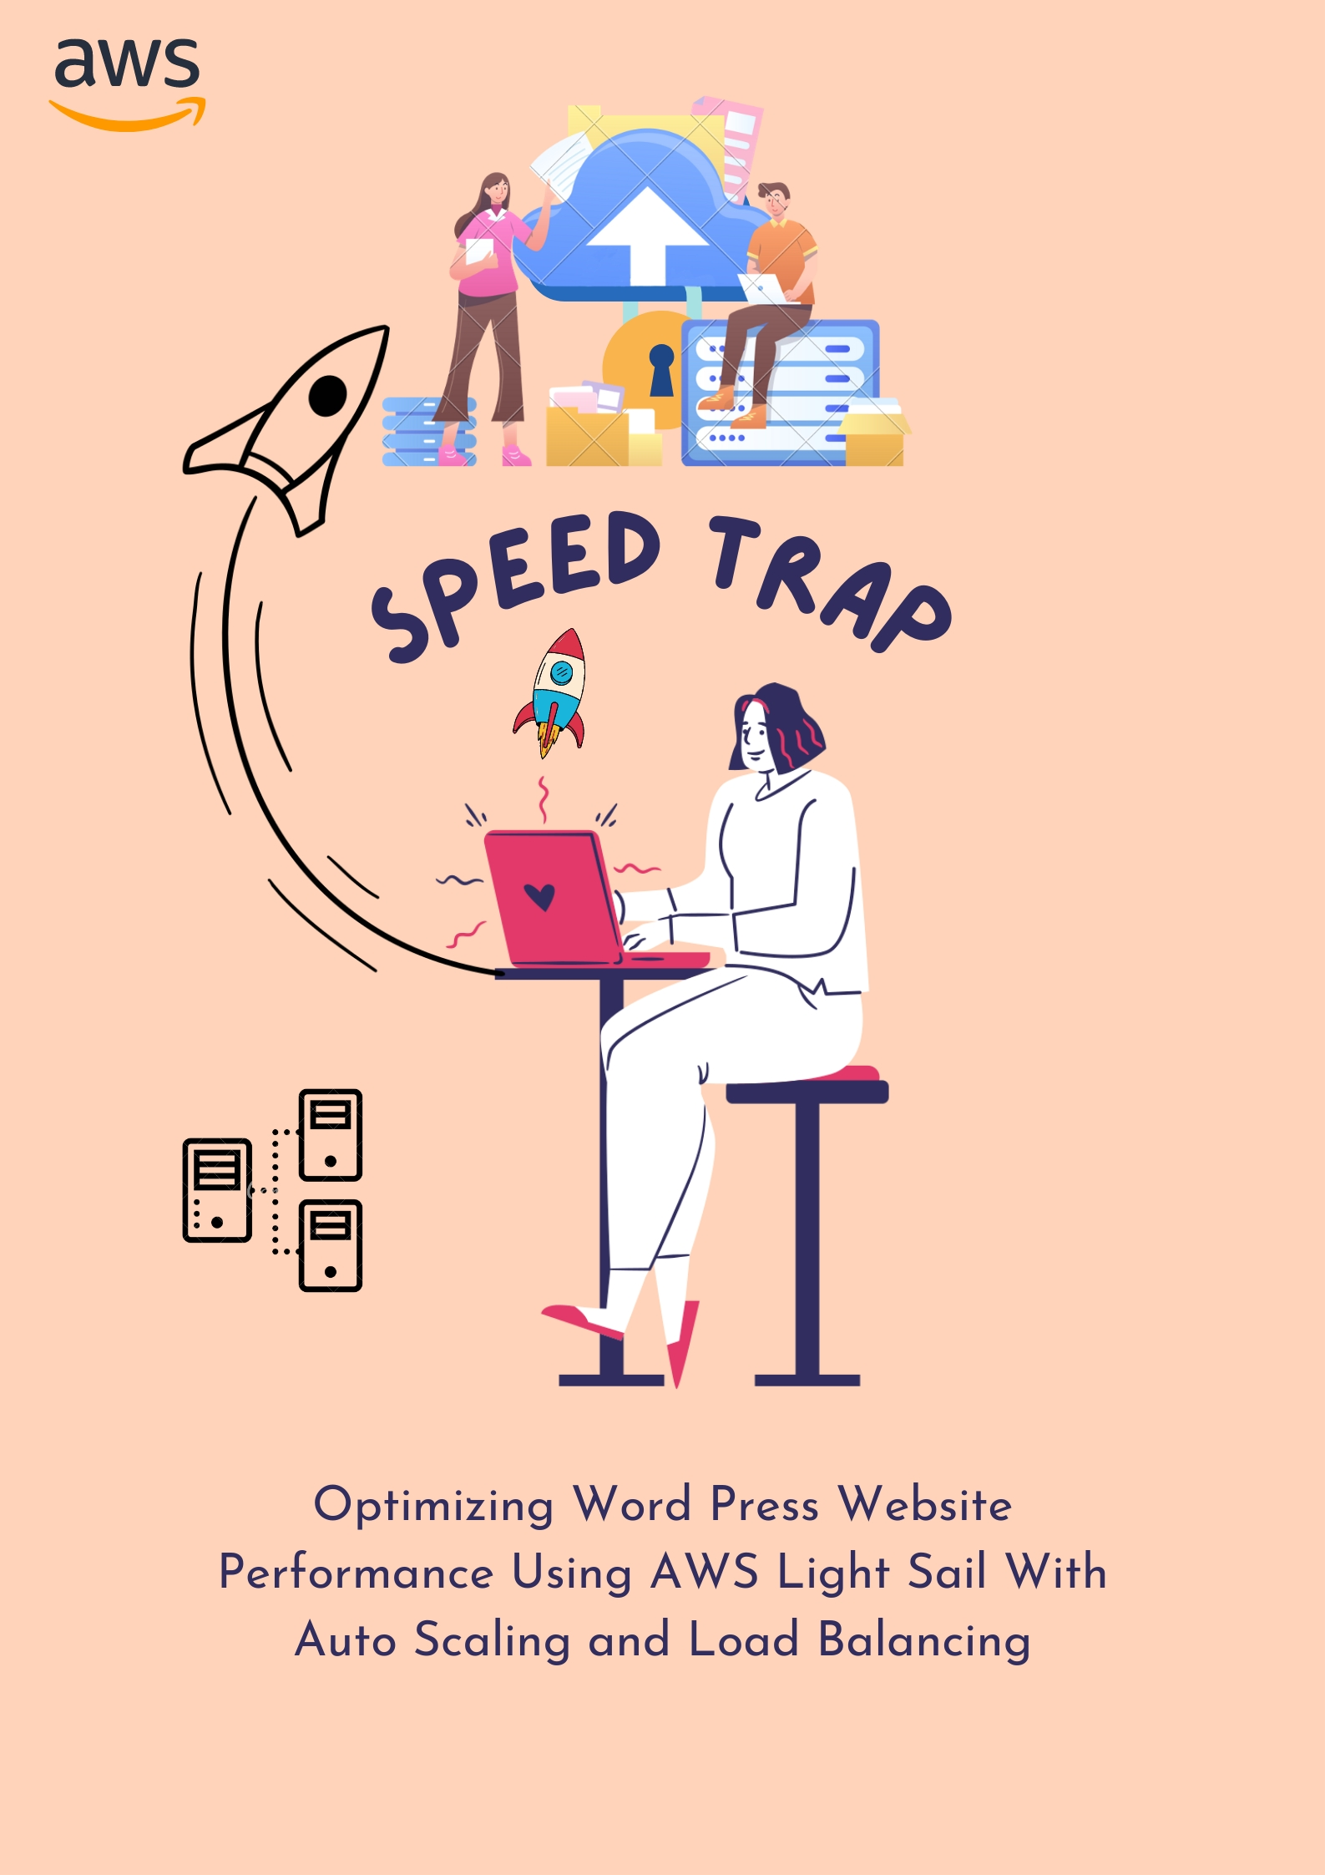

Slide 11
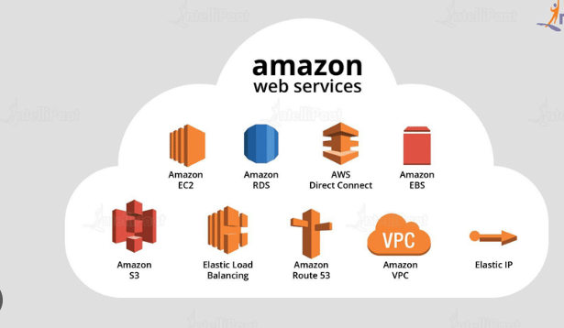
Services Used In Project
AWS Light sail
AWS NETWORKING
AWS DATABASE
AWS IAM
AWS AUTO SCALLING
AWS LOAD BALANCING
AWS S3
Word Press

Slide 12
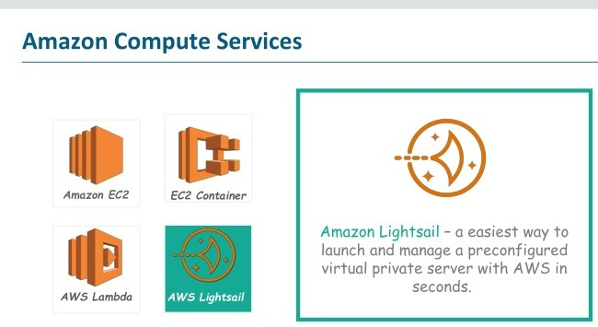
Amazon LightSail
It offers virtual servers, storage, databases, and networking, plus a cost-effective, monthly plan.
Virtual servers, storage, databases, and networking
Low & predictable pricing
Can setup notifications and monitoring of your LightSail resources.

Slide 13
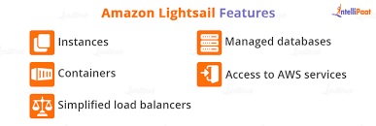
WHY Lightsail ??

Slide 14
AWS Load Balancing includes
Load balancing is another important feature of AWS Lightsail that ensures high availability of the website. It distributes the incoming traffic across multiple instances of the website, so that if one instance becomes unavailable, the other instances can take over and ensure that the website remains available to users.
There are following types of Load balancer :-
Application load balancer
Network load balancer
Classic load balancer

Slide 15
AWS auto-scaling includes
Auto scaling is a feature of AWS Light sail that automatically adjusts the number of resources allocated to a website based on the current demand. This means that during times of high traffic, the website's resources will be increased to ensure that it can handle the increased load, and during times of low traffic, the resources will be reduced to minimize costs.
Better fault tolerance: Auto-scaling helps in determining and detecting which of the instances present on the server is unhealthy. Once established, the unhealthy instance is quickly terminated, and another healthy instance is sent as a replacement for the unhealthy one.
Better availability: Auto-scaling helps in ensuring that the application has the right amount of capacity for handling the current traffic demand

Slide 16
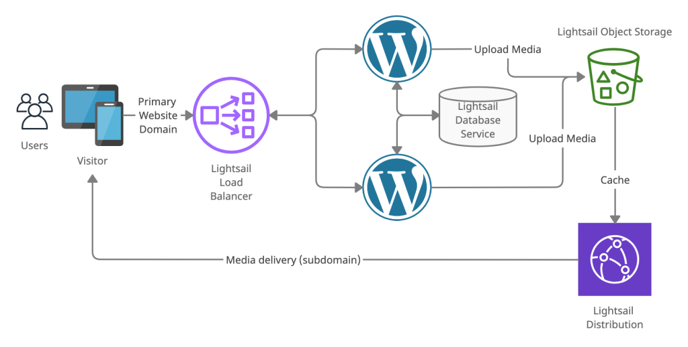

Slide 17

Website View

Slide 18


Slide 19



Slide 20
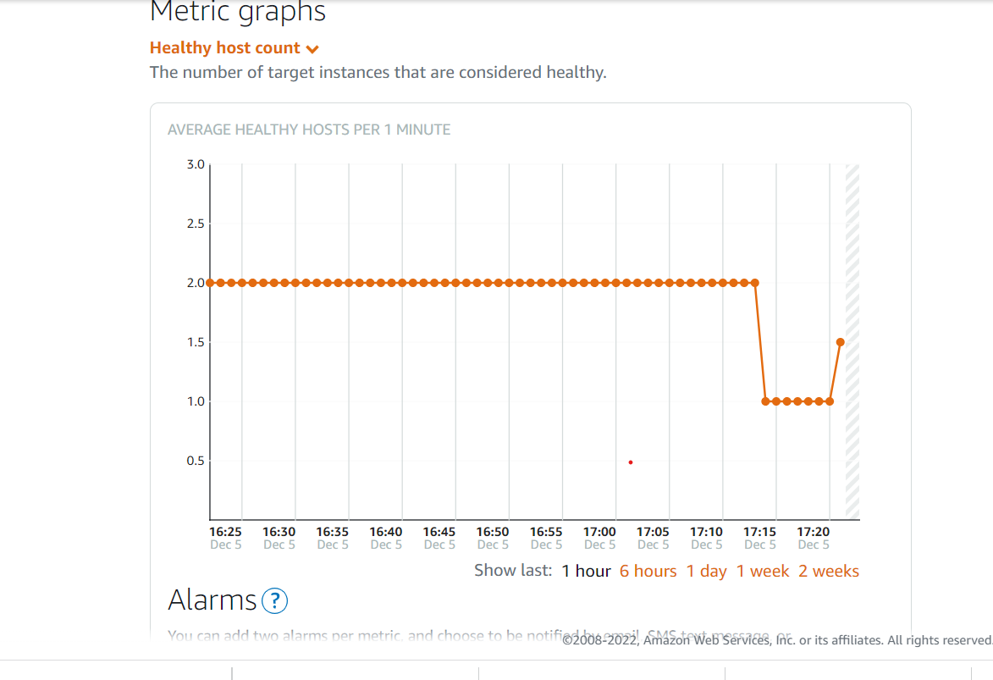
Instance Balancing

Slide 21
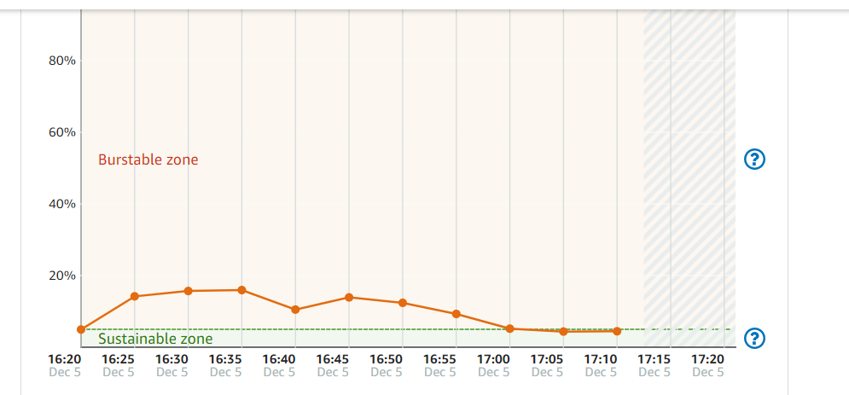
Website Health

Slide 22
Thanks!

